Slide 1
Abstract Datatypes

Slide 2
Abstract Datatype
Abstract data type is special kind of data type, whose behavior is defined by a set of values and set of operations.
The keyword “Abstract” is used as we can use these data types, we can perform different operations. But how those operations are working that is totally hidden from the user.
The ADT is made of primitive data types, but operation logics are hidden.
It is called “abstract” because it gives an implementation-independent view.
Some examples of ADT are Stack, Queue, List etc.

Slide 3
Linked List
linked list is a linear data structure that stores a collection of data elements dynamically
Linked list can grow and shrink its size, as per the requirement.
It does not waste memory space.
A linked list consists of a data element known as a node.

Slide 4
Difference between datatypes and Abstract Datatypes
Data Type is basically a type of data that can be used in different computer program. It signifies the type like integer, float etc,
in order to simplify the process of solving problems, we can create data structures along with their operations, and such data structures that are not in-built are known as Abstract Data Type (ADT).
Think of ADT as a black box which hides the inner structure and design of the data type.

Slide 5
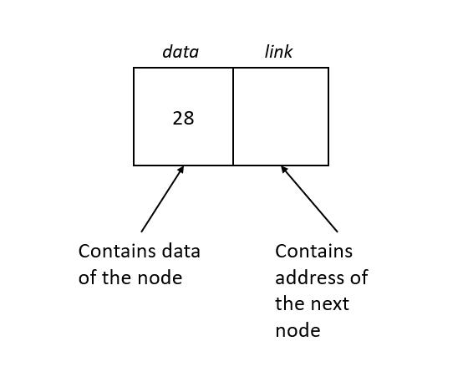
Linked List

Slide 6
Types of linked list
Singly Linked List Doubly Linked List Circular Linked List

Slide 7
Why linked list data structure needed?
Dynamic Data structure: The size of memory can be allocated or de-allocated at run time based on the operation insertion or deletion. Ease of Insertion/Deletion: The insertion and deletion of elements are simpler than arrays since no elements need to be shifted after insertion and deletion, Just the address needed to be updated. Efficient Memory Utilization: As we know Linked List is a dynamic data structure the size increases or decreases as per the requirement so this avoids the wastage of memory. Implementation: Various advanced data structures can be implemented using a linked list like a stack, queue, graph, hash maps, etc

Slide 8
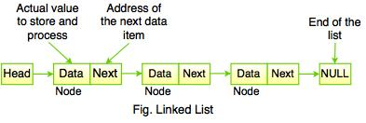
Singly Linked List
Most common type of linked list. Each node has data and an address field that contains a reference to the next node.
First node in the list is called the head, and the last node in the list is called the tail.

Slide 9
Operations on singly linked list
Insertion: The insertion operation can be performed in three ways. They are as follows… Inserting At the Beginning of the list Inserting At End of the list Inserting At Specific location in the list Deletion: The deletion operation can be performed in three ways. They are as follows… Deleting from the Beginning of the list Deleting from the End of the list Deleting a Specific Node Search: It is a process of determining and retrieving a specific node either from the front, the end or anywhere in the list. Display: This process displays the elements of a Single-linked list.

Slide 10
Operations on singly linked list-Insertion at Beginning
Inserting a new element into a singly linked list at beginning is quite simple.
Allocate the space for the new node and store data into the data part of the node.
Make the link part of the new node pointing to the existing first node of the list.
At the last, we need to make the new node as the first node of the list

Slide 11
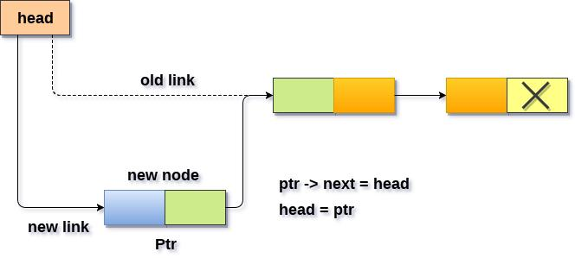
Operations on singly linked list-Insertion at Beginning

Slide 12
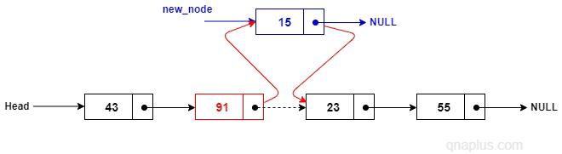
Operations on singly linked list-Insertion at Random

Slide 13
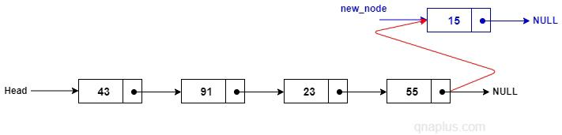
Operations on singly linked list-Insertion at End

Slide 14
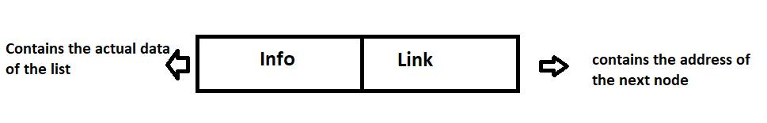
Creation of a node
struct node {
int data;
struct node *next; };

